Slide 1
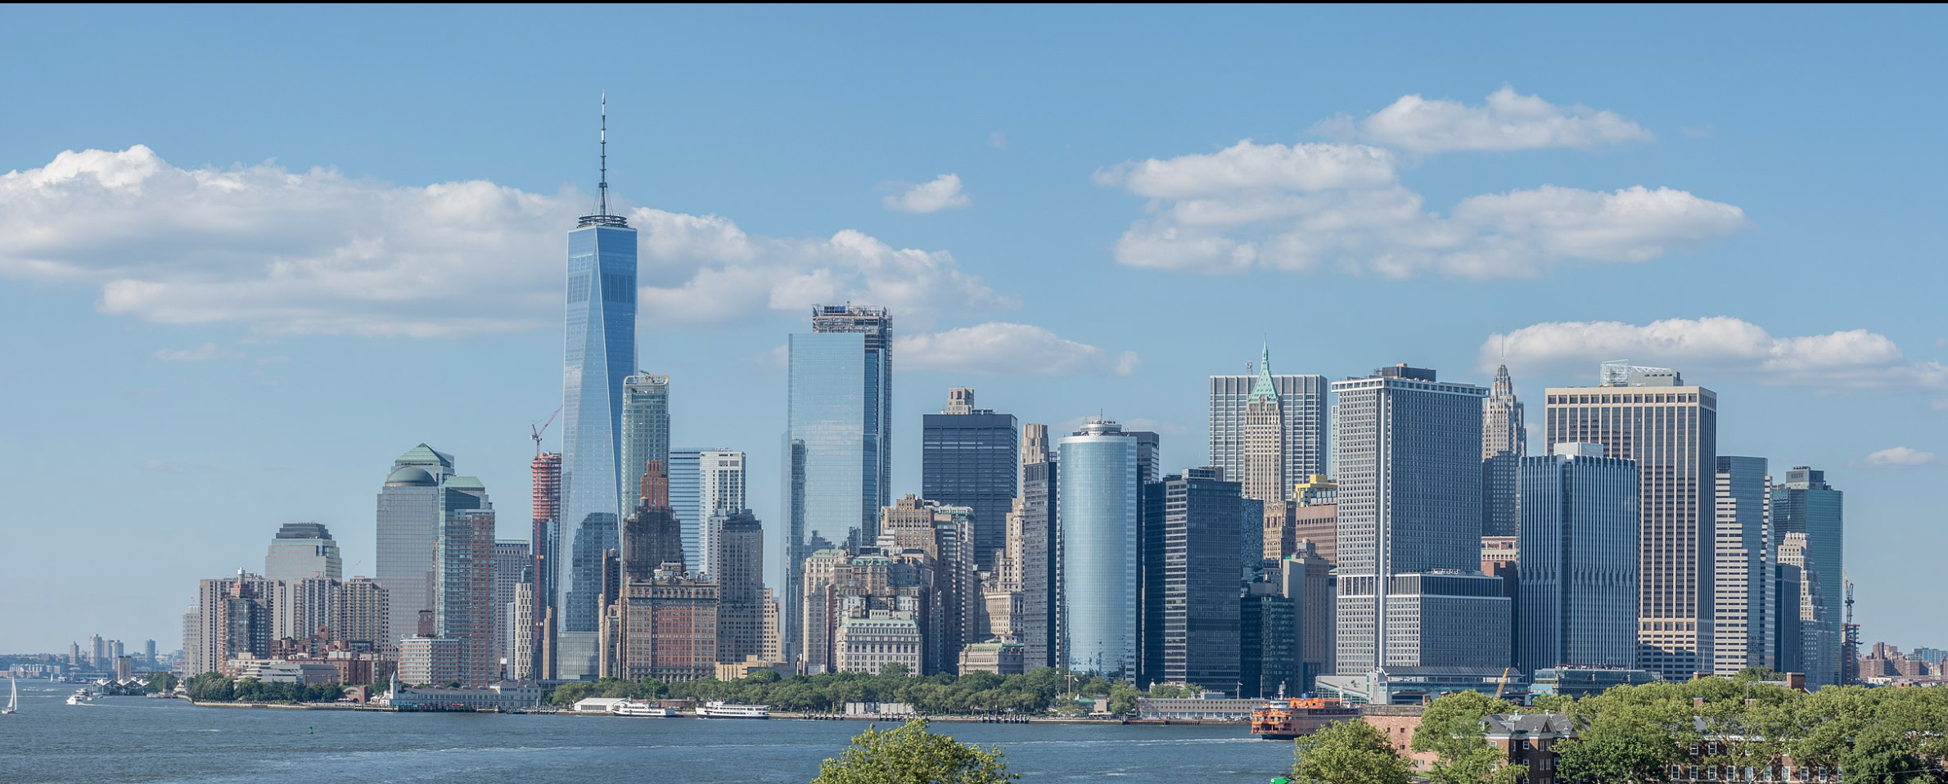
Comparing New York City and Toronto: Most Popular Venues

Slide 2
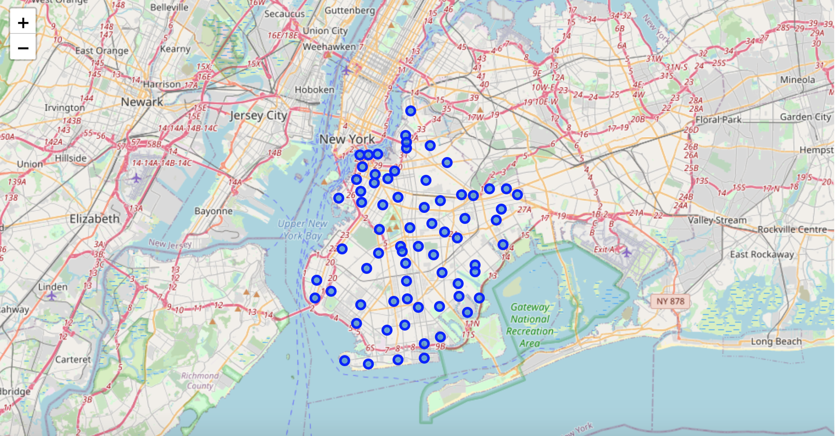
New York City

Slide 3
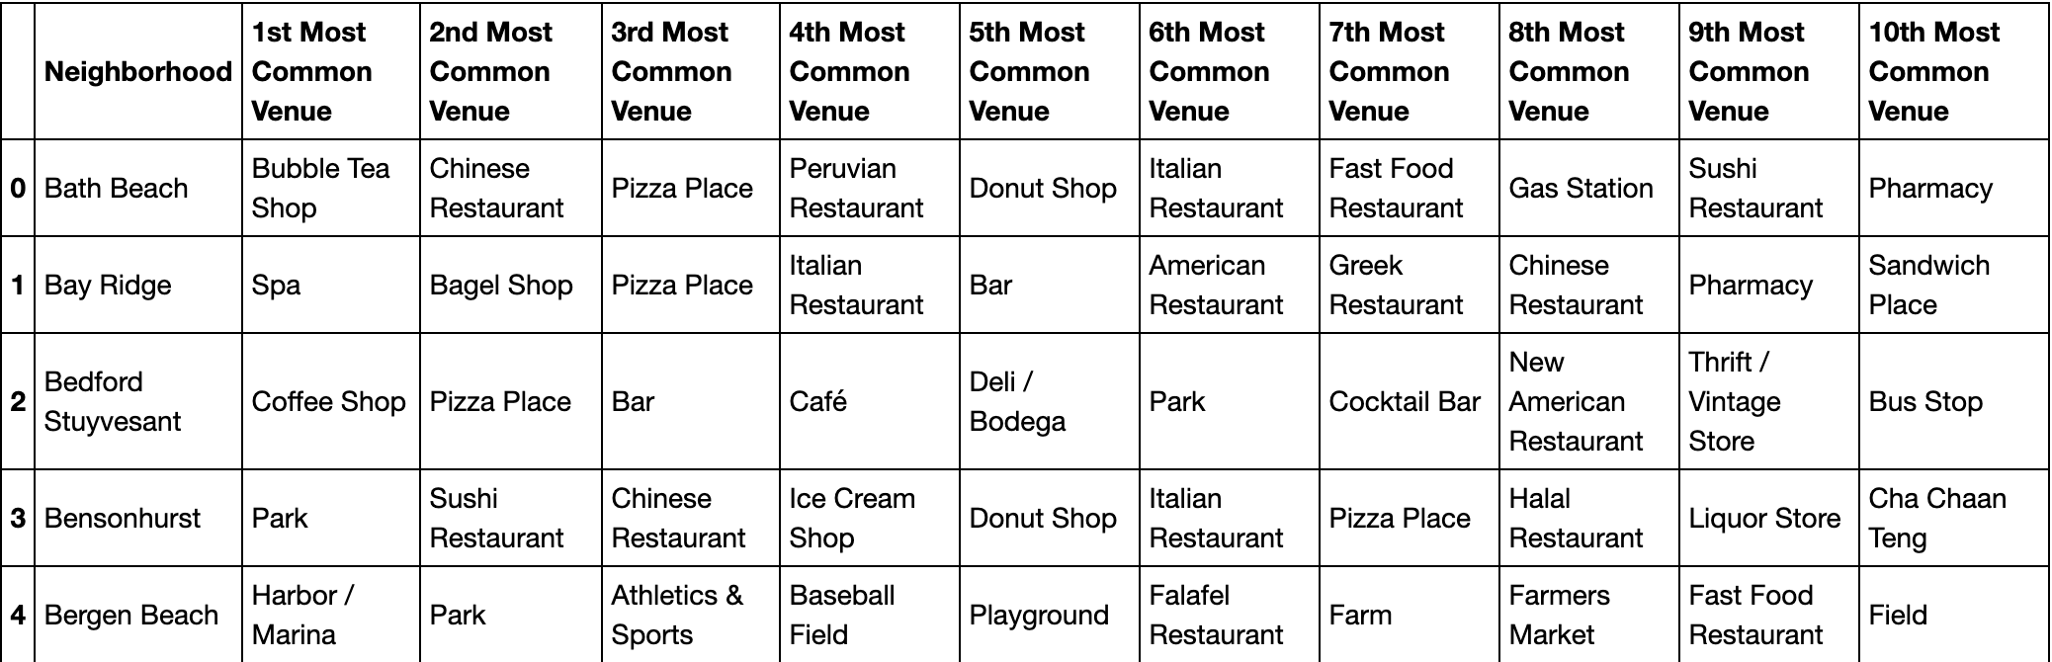
NYC: Most Popular Venues

Slide 4
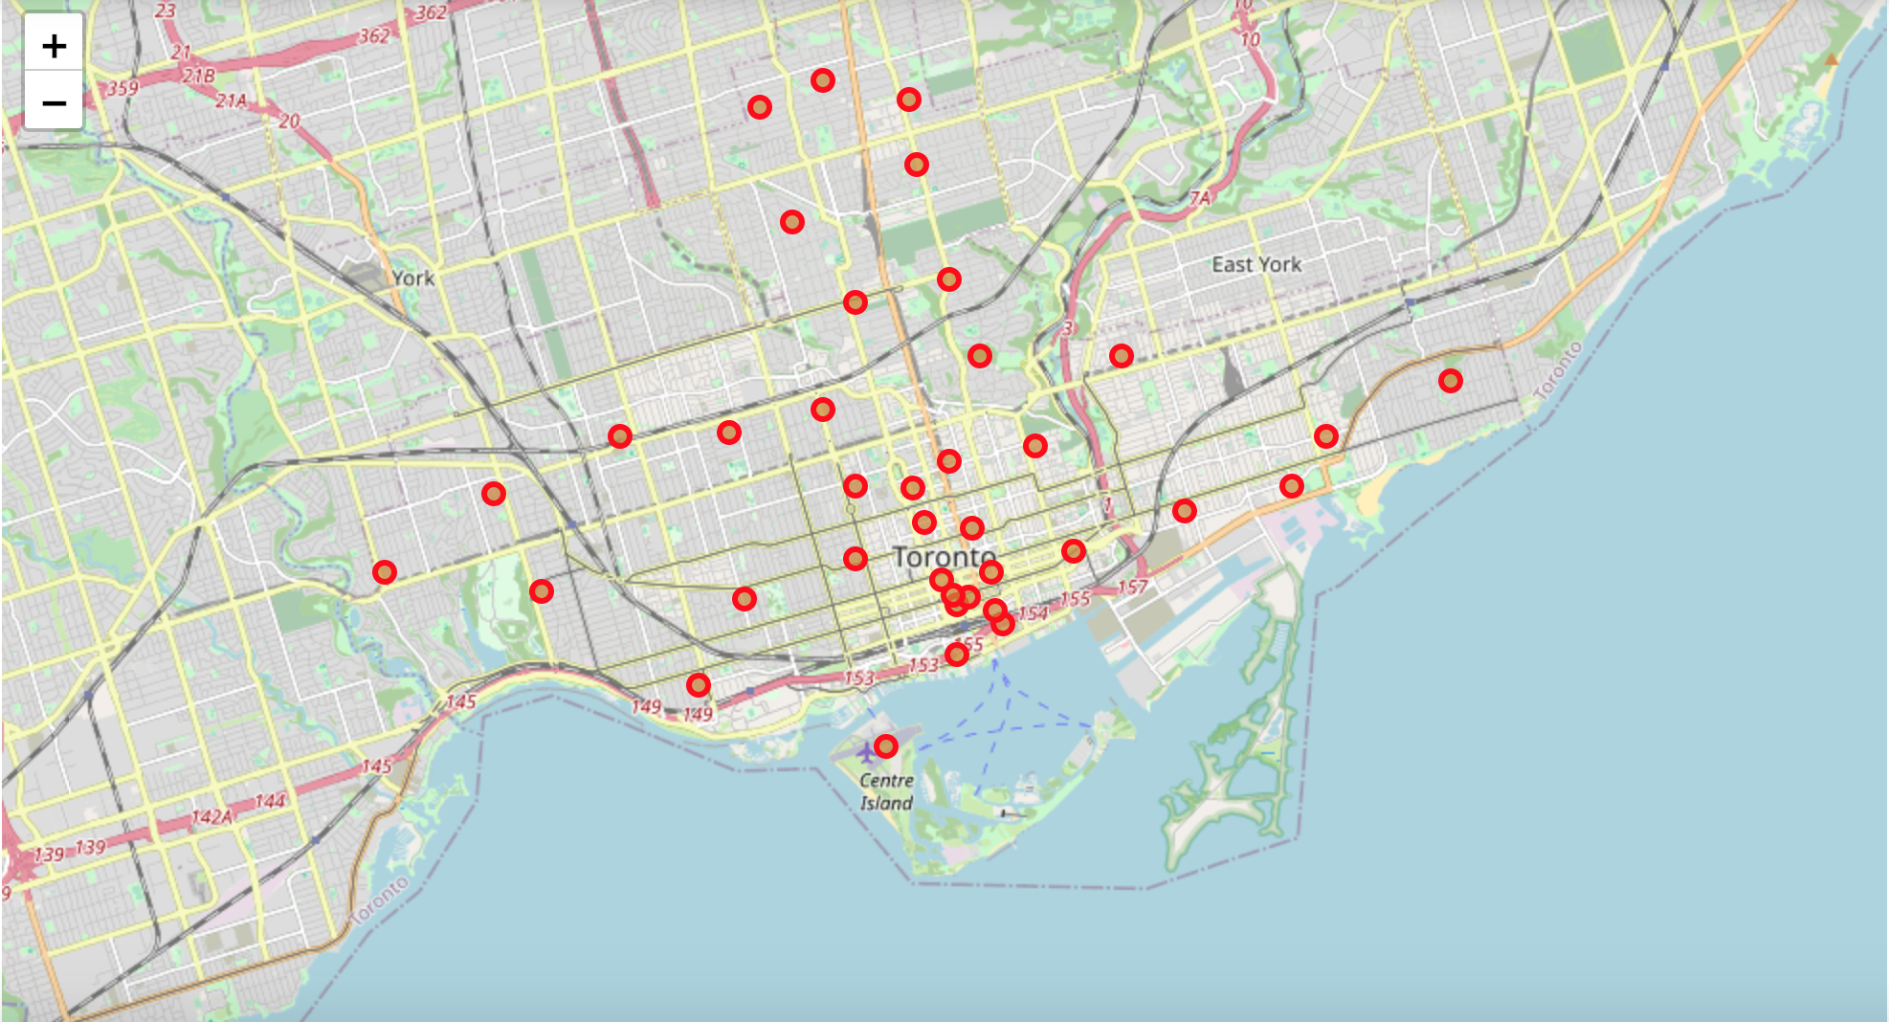
Toronto

Slide 5
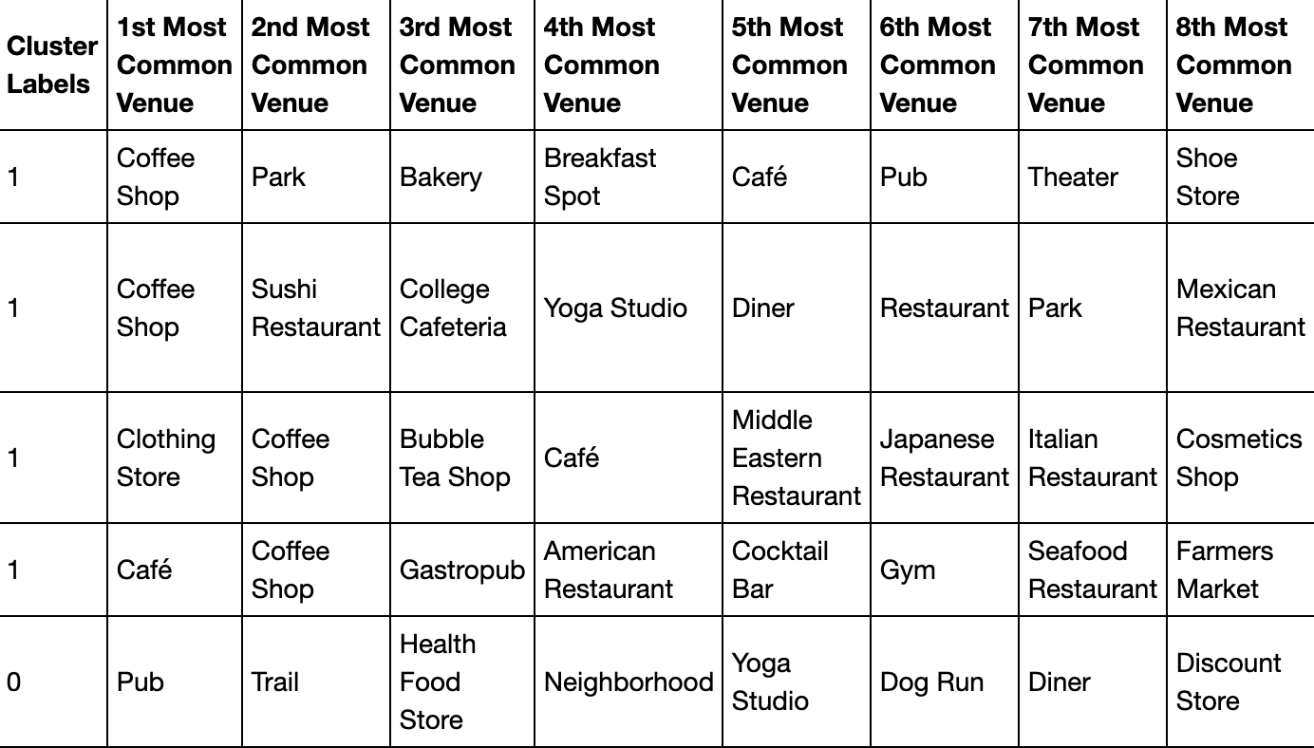
Toronto: Most Popular Venues

